Slide 1
Applying the Scikit Learn Machine Learning Toolbox on the Stock Market
Alexander Wendt

Slide 2
Motivation
Collect knowledge and good scripts in one place
Less Stack Overflow
Complete machine learning process with less customization
Not AutoML
Fast data analysis
Teach others

Slide 3
Research Question
How much manual customization can be reduced by using prepared scripts for common machine learning problems with structured datasets?

Slide 4
Methodology
Add all known preprocessing steps into scripts
Add all training algorithms and hyperparameter optimization steps into modular scripts
Add all graphics and evaluation into scripts
Idea: Better to reduce from script templates than writing new code

Slide 5
SKLearn Machine Learning Process
Github: https://github.com/alexanderwendt/sklearn_ml_toolbox
Main Blocks of Pipe
Step 1: Gather raw data
Step 2: Generate features and outcomes
Step 3: Prepare and analyze data
Step 4: Get best hyperparameters
Step 5: Train model
Step 6: Evaluate model performance
Step 7: Infer new data

Slide 6
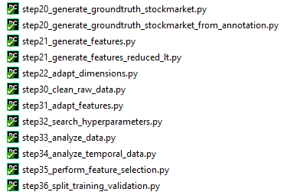
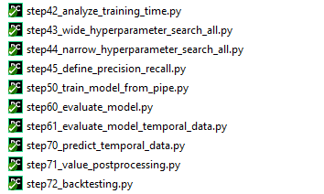
Structure in Github – Processing Pipeline

Slide 7
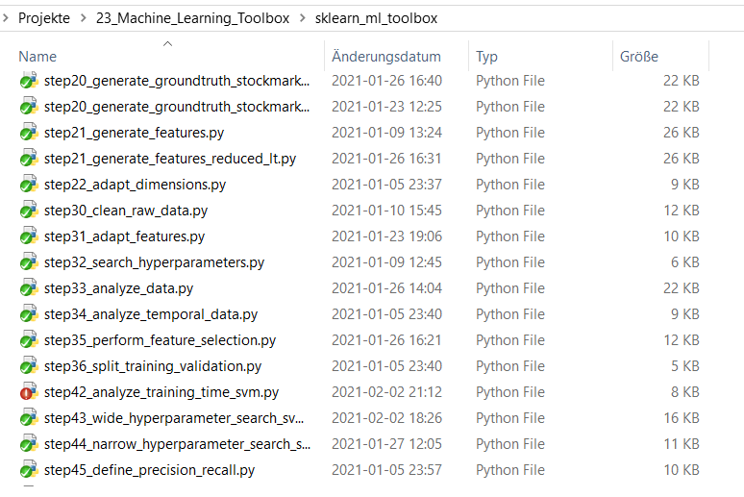
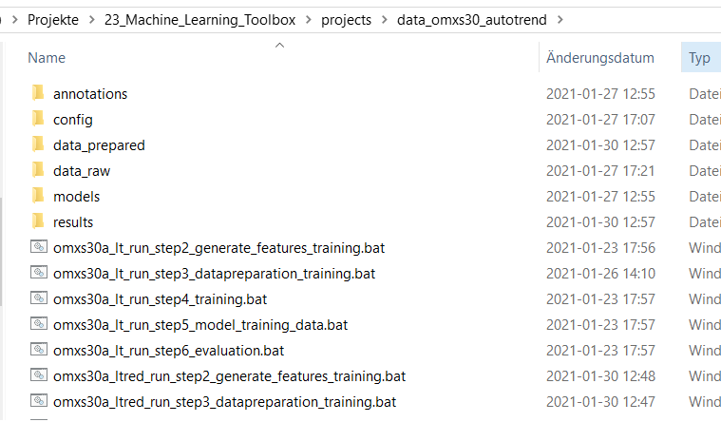
Efficient Coding – Good Pattern for Pipes
Source Code from Git
Project instance

Slide 8
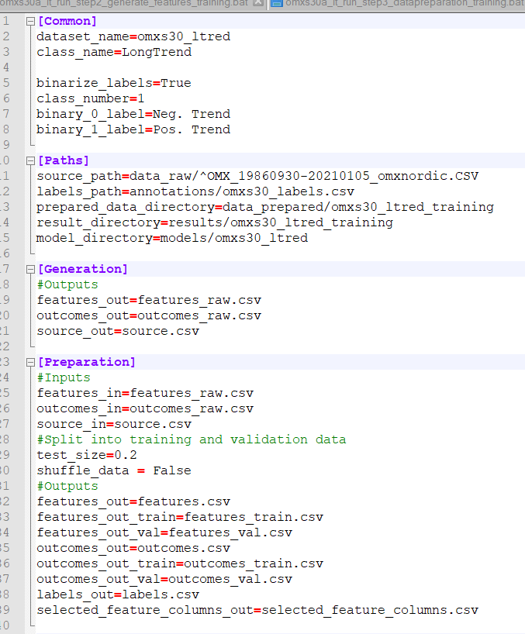
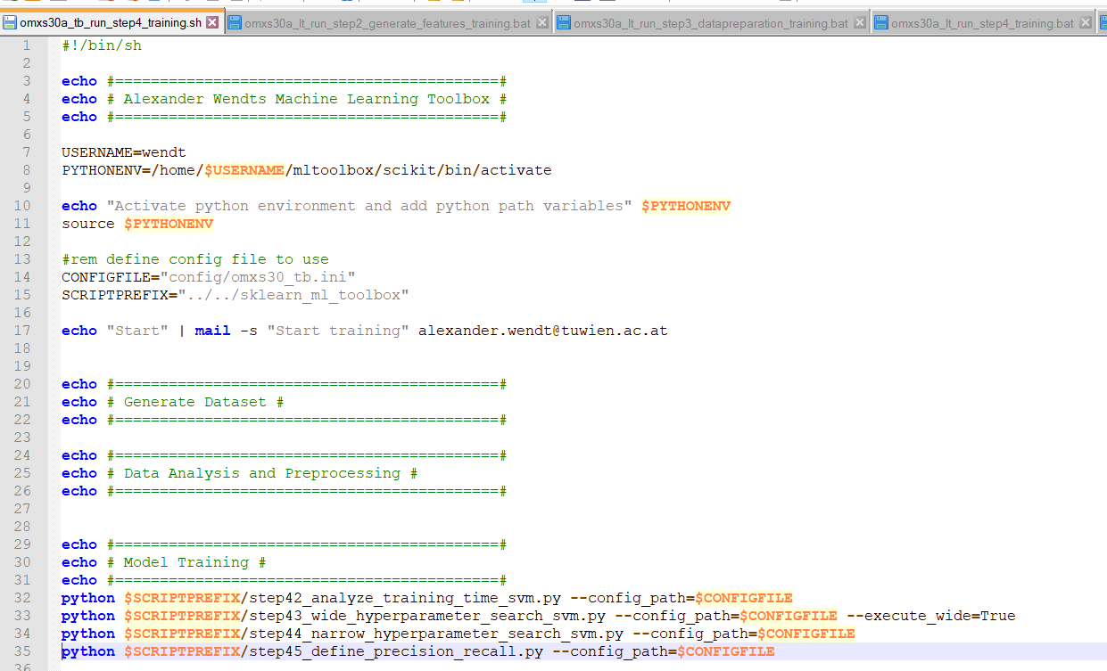
Efficient Coding – bat/sh

Slide 9
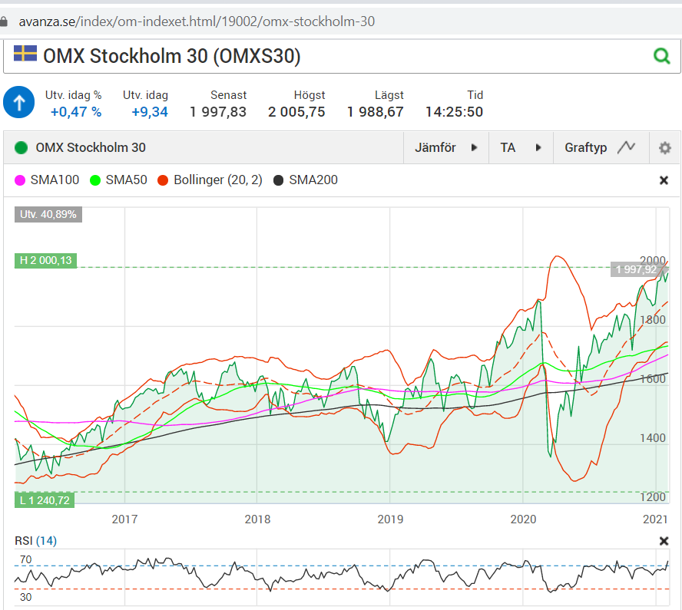
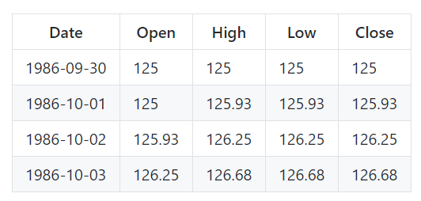
Step 1.0 – Get Raw Data
How good do technical indicators describe current stock market trend?
OMXS30 Index from http://www.nasdaqomxnordic.com

Slide 10
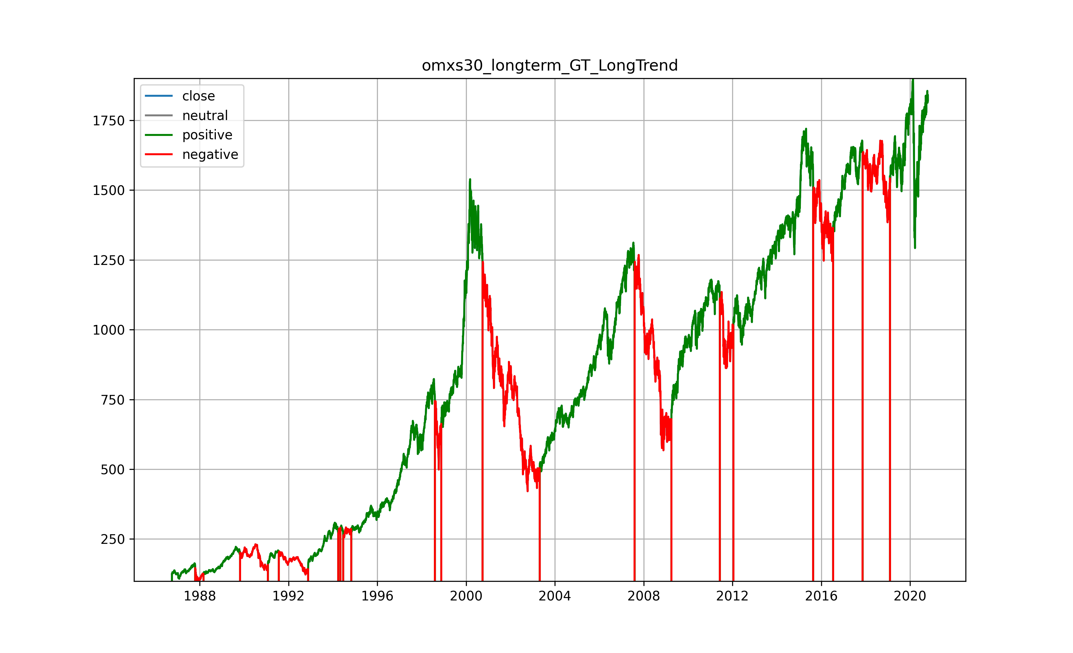
Step 2.0 – Generate Outcomes
Time series
Automatic trend recognition with future variables

Slide 11
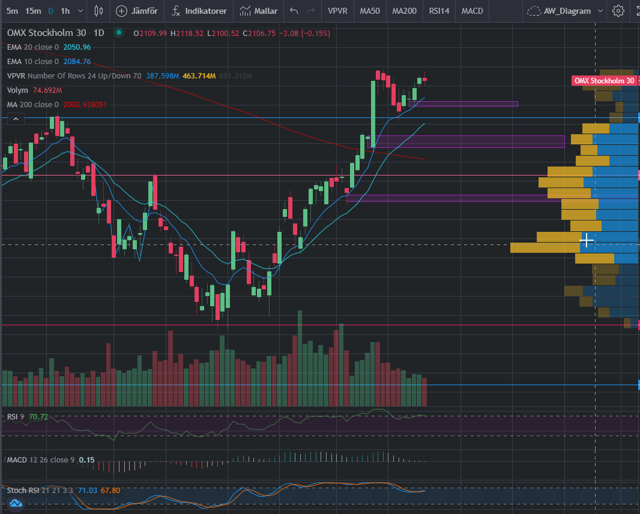
Step 2.1 – Generate Features
Technical indicators capture history
Examples derivated from price
Moving Averages 200, 21, 9
RSI 9 (extreme)
MACD 12, 26
Stochastics-RSI 21, 21, 3, 3
Convert to relative values

Slide 12
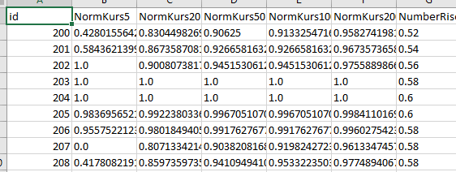
Step 3.0-3.1 – Data Cleaning and Adaptation
Cleaning
Column names are stripped
" " are replaced by "_" to get unified naming
"/" are replaced by "-"
All string values "?" or empty values are replaced by numpy "NaN"
Adaptation
Binarize Labels: One vs. All
Nominals: One-hot-encoding
All to int or float

Slide 13
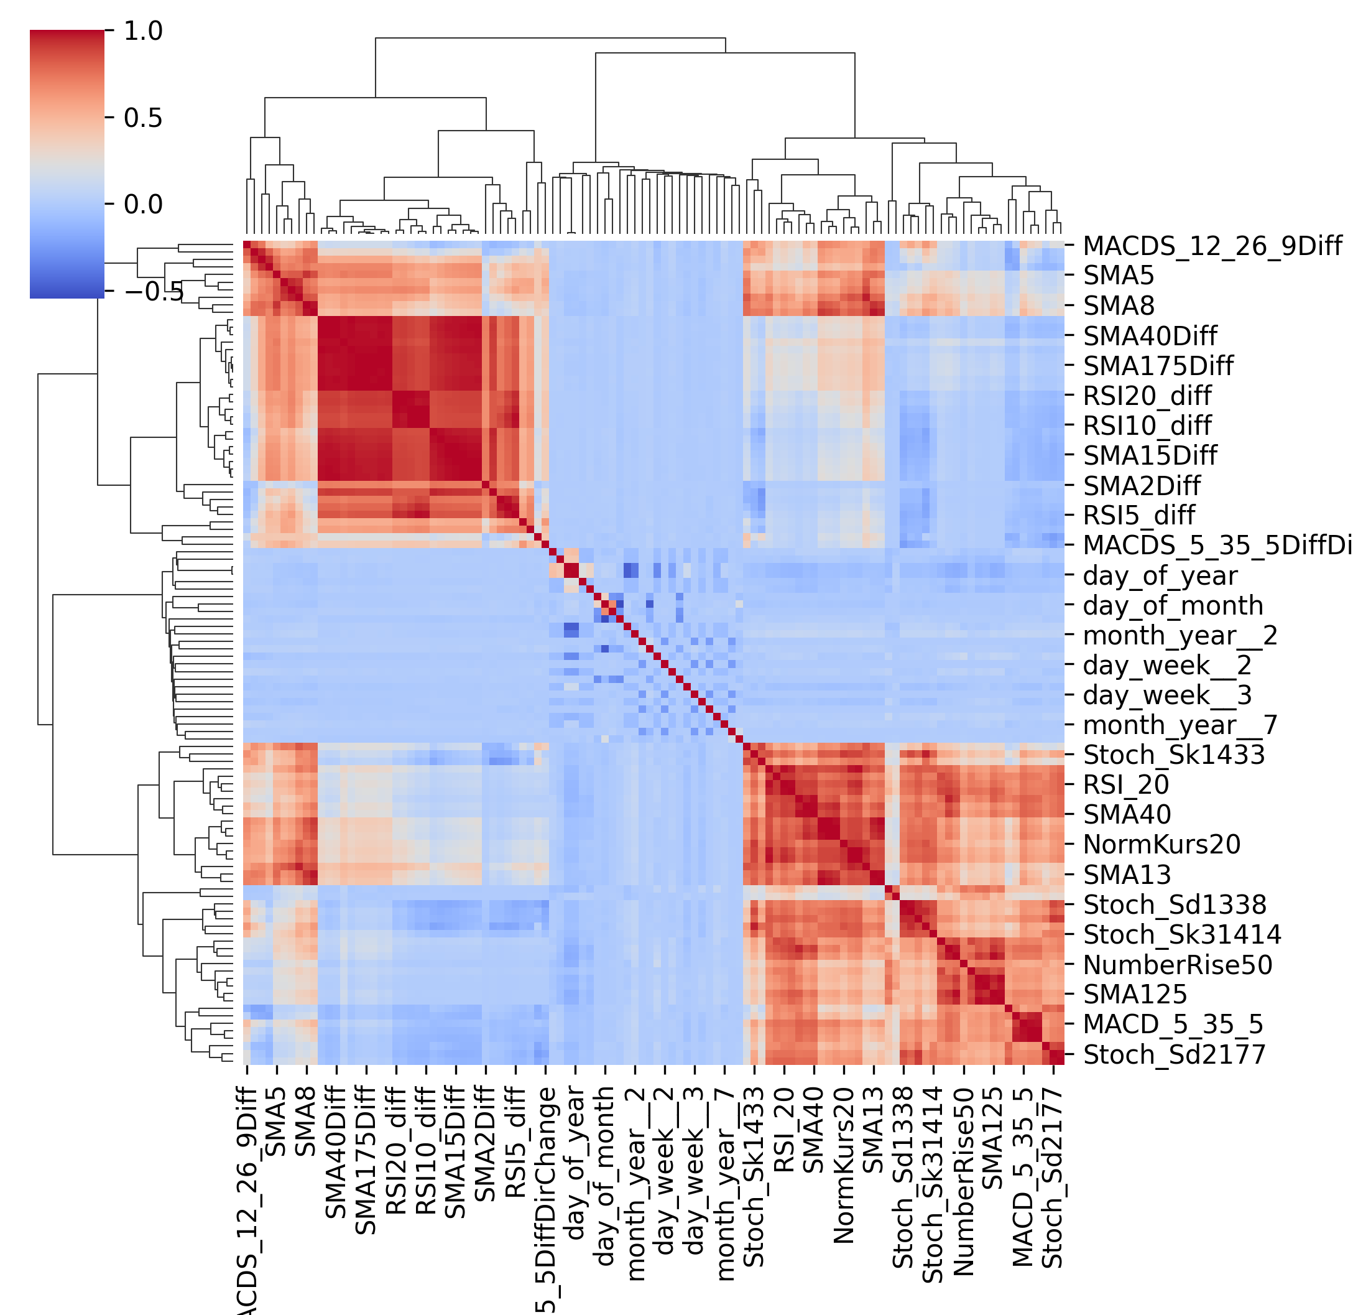
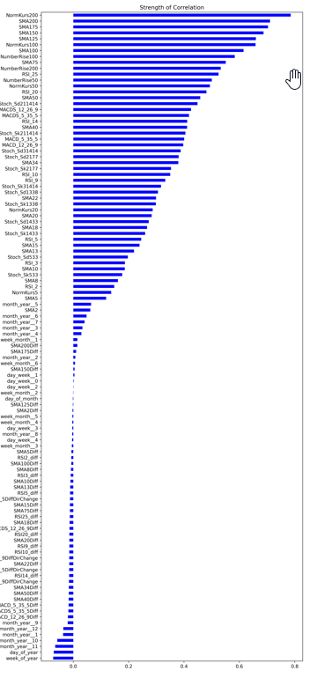
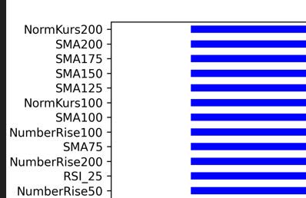
Step 3.3 – Data Analysis Relevance
Hierarchical Linkage
Feature Importance
Visual correlation analysis
See important features

Slide 14
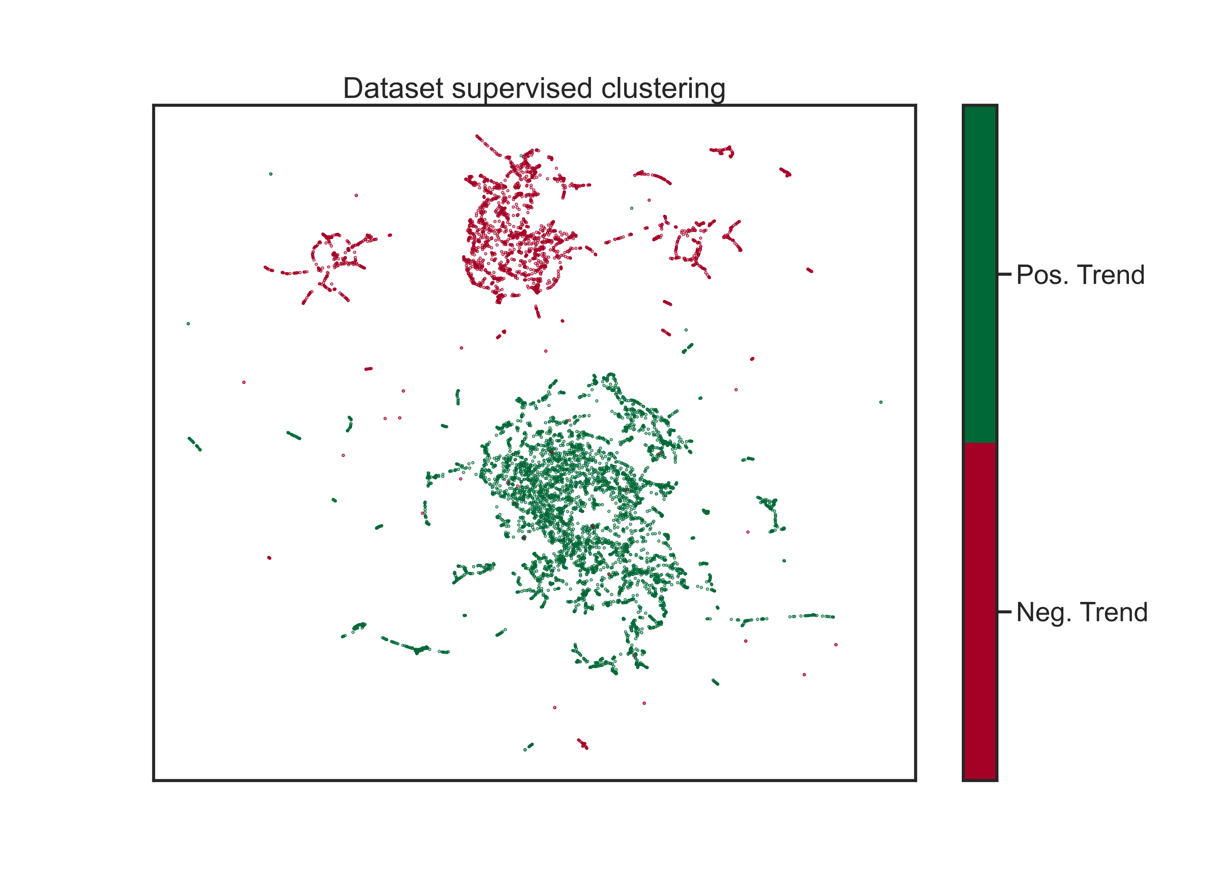
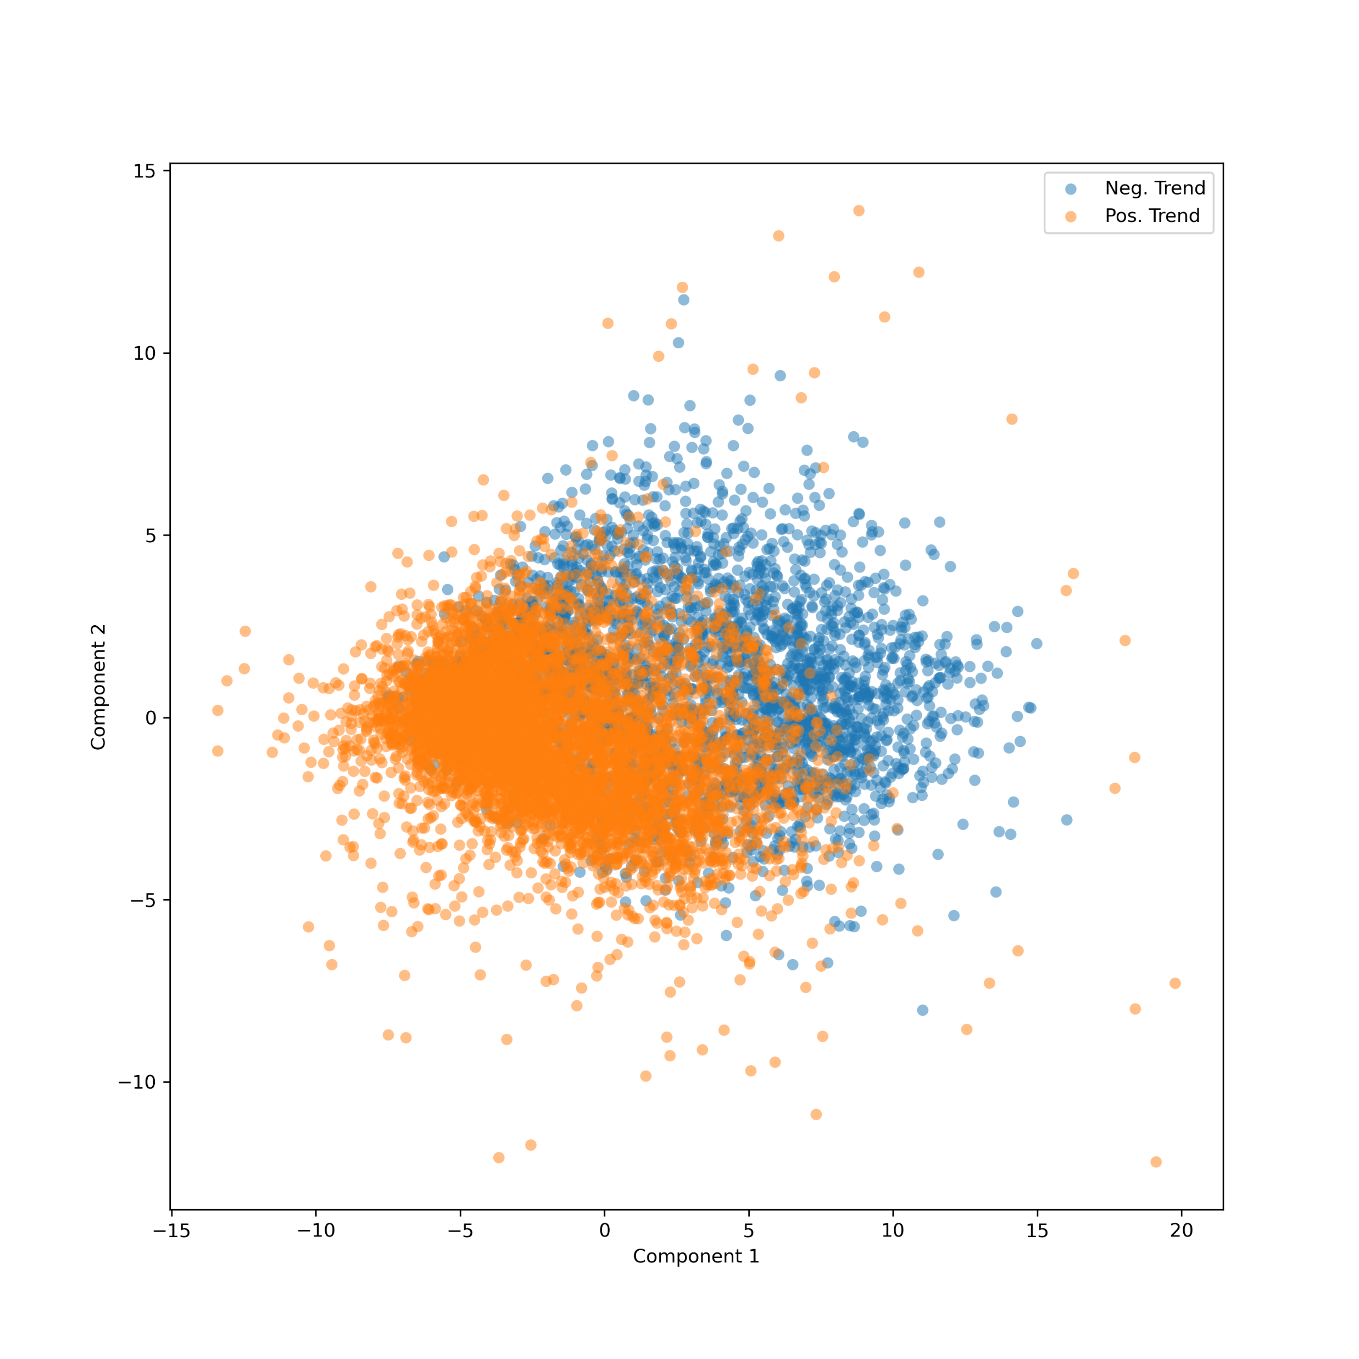
Step 3.3 – Data Analysis Clustering
Cluster analysis
Unsupervised: Prinipal Component Analysis (PCA)
UMAP
See how well data can be grouped
Supervised UMAP
PCA

Slide 15
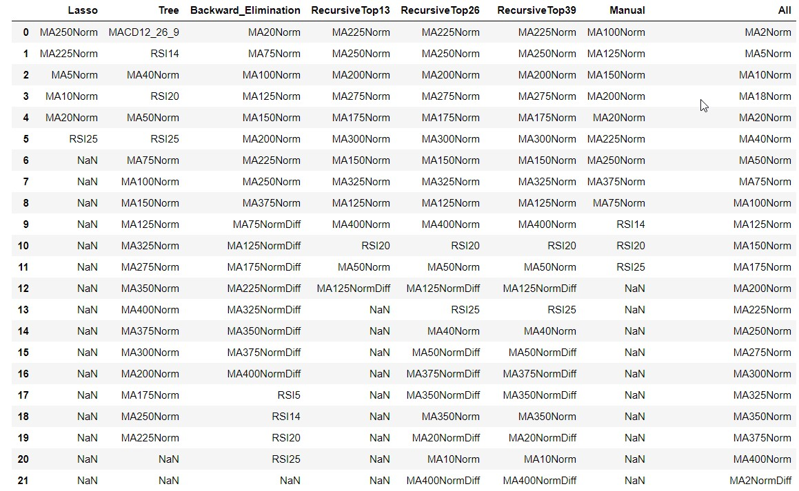
Step 3.5 – Feature Selection
Remove low correlated features
Lasso, Decision Tree, Backward elimination, Recursive
Purpose
Make faster models (SVM max 80 features)
Remove noise
Sometimes get better results

Slide 16
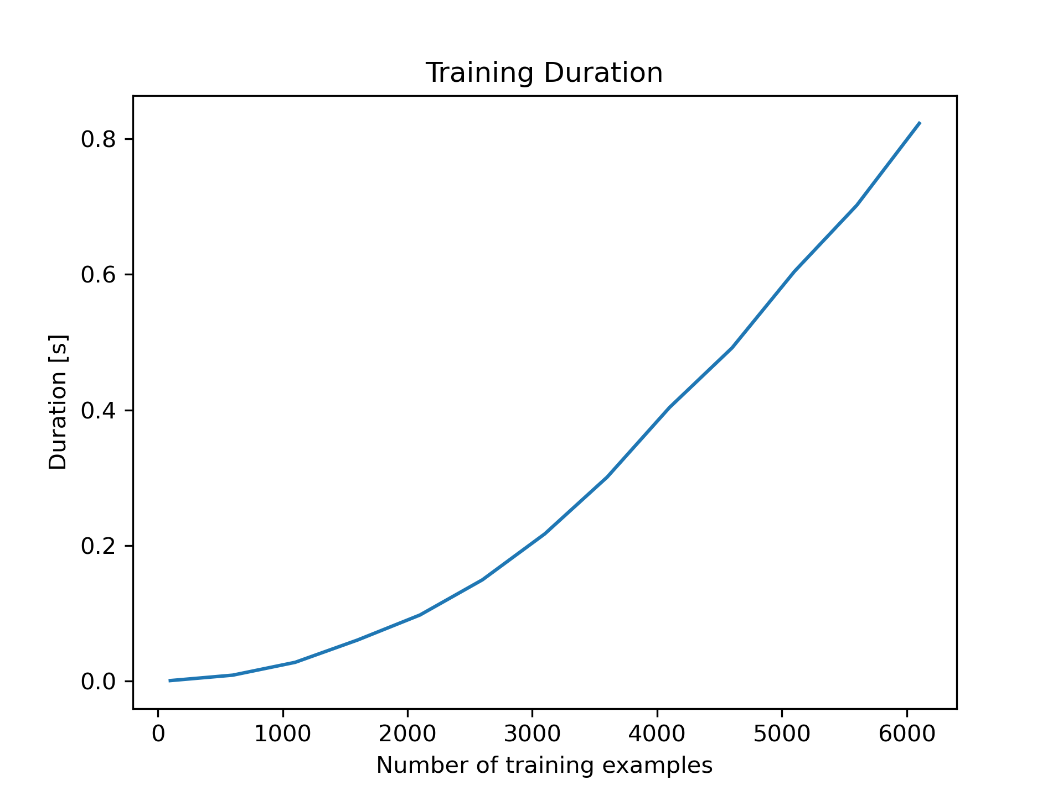
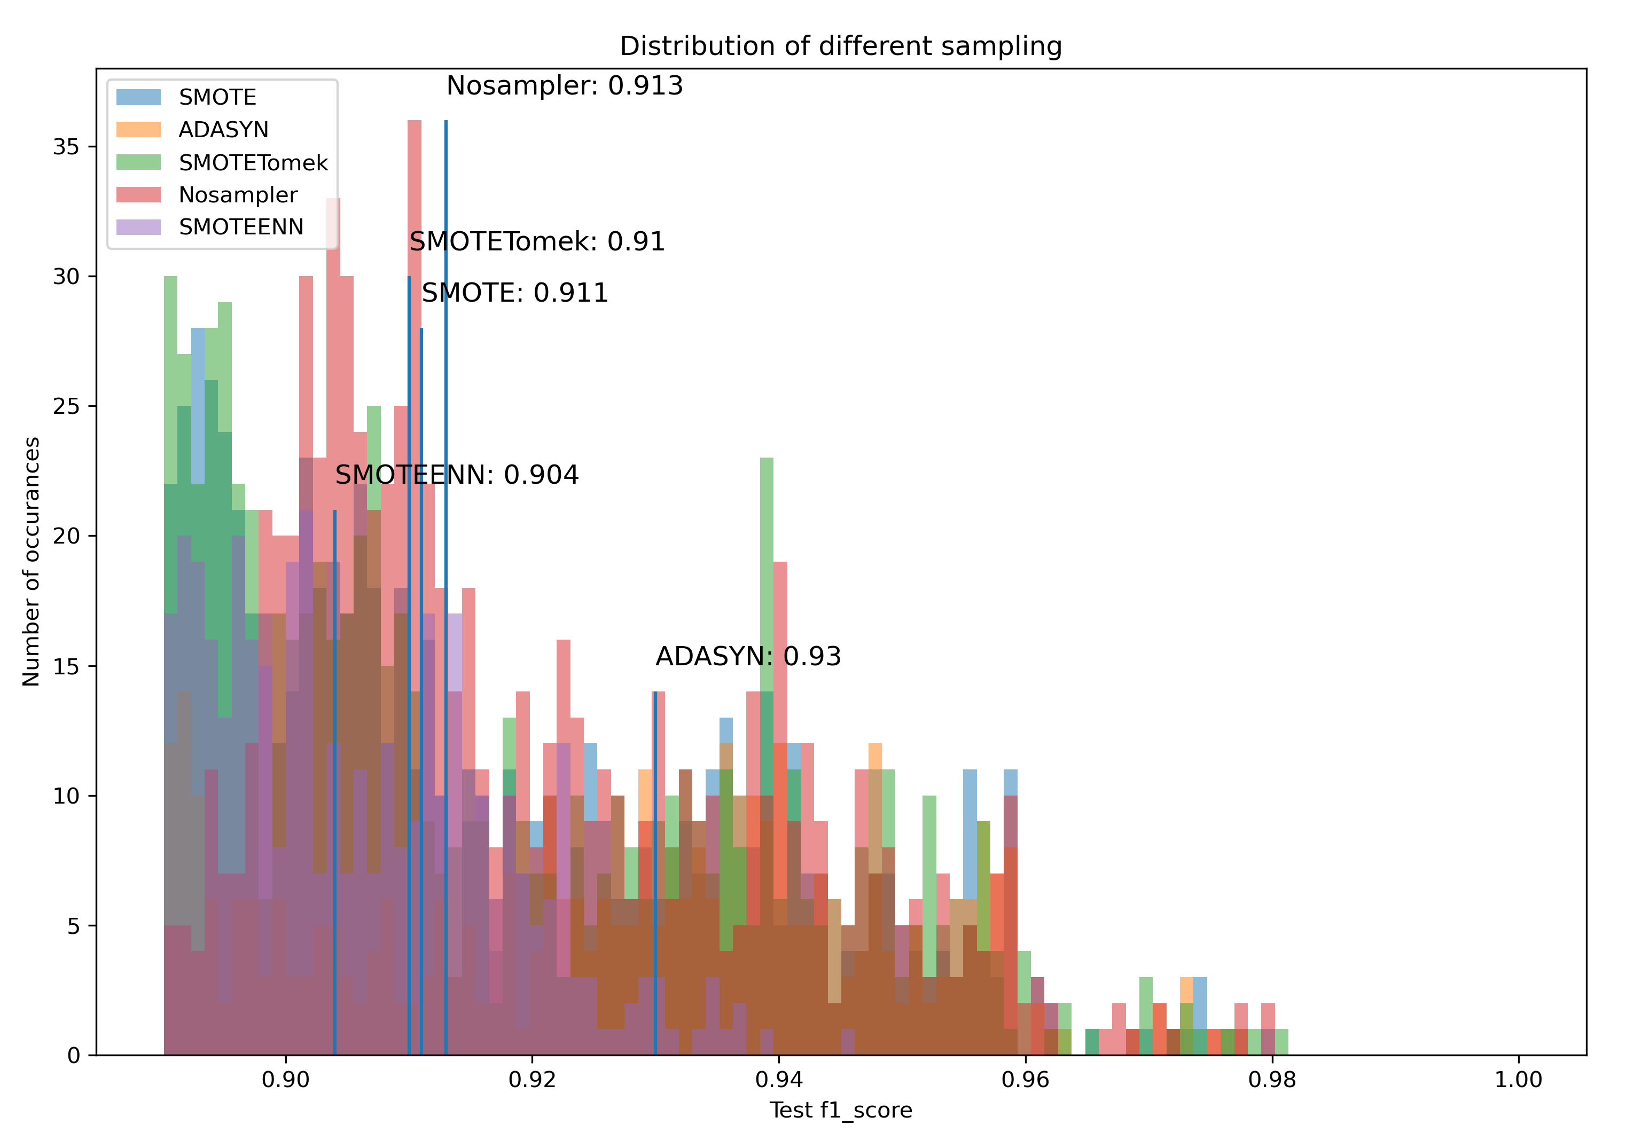
Step 4.3 – Find Best Hyperparameters Wide Search
Two Phase Hyperparameter Search*
Phase 1: Determine discrete values with less data
Support Vector Machine
*Wendt, A., Wuschnig, M., Lechner M.: Speeding up Common Hyperparameter Optimization Methods by a Two-Phase-Search. In proceedings of IECON 46th Annual Conference of the IEEE Industrial Electronics Society (IES), 2020, Singapore (online), ISBN: 978-1-7281-5413-8/20, pp. 517-522, 2020

Slide 17
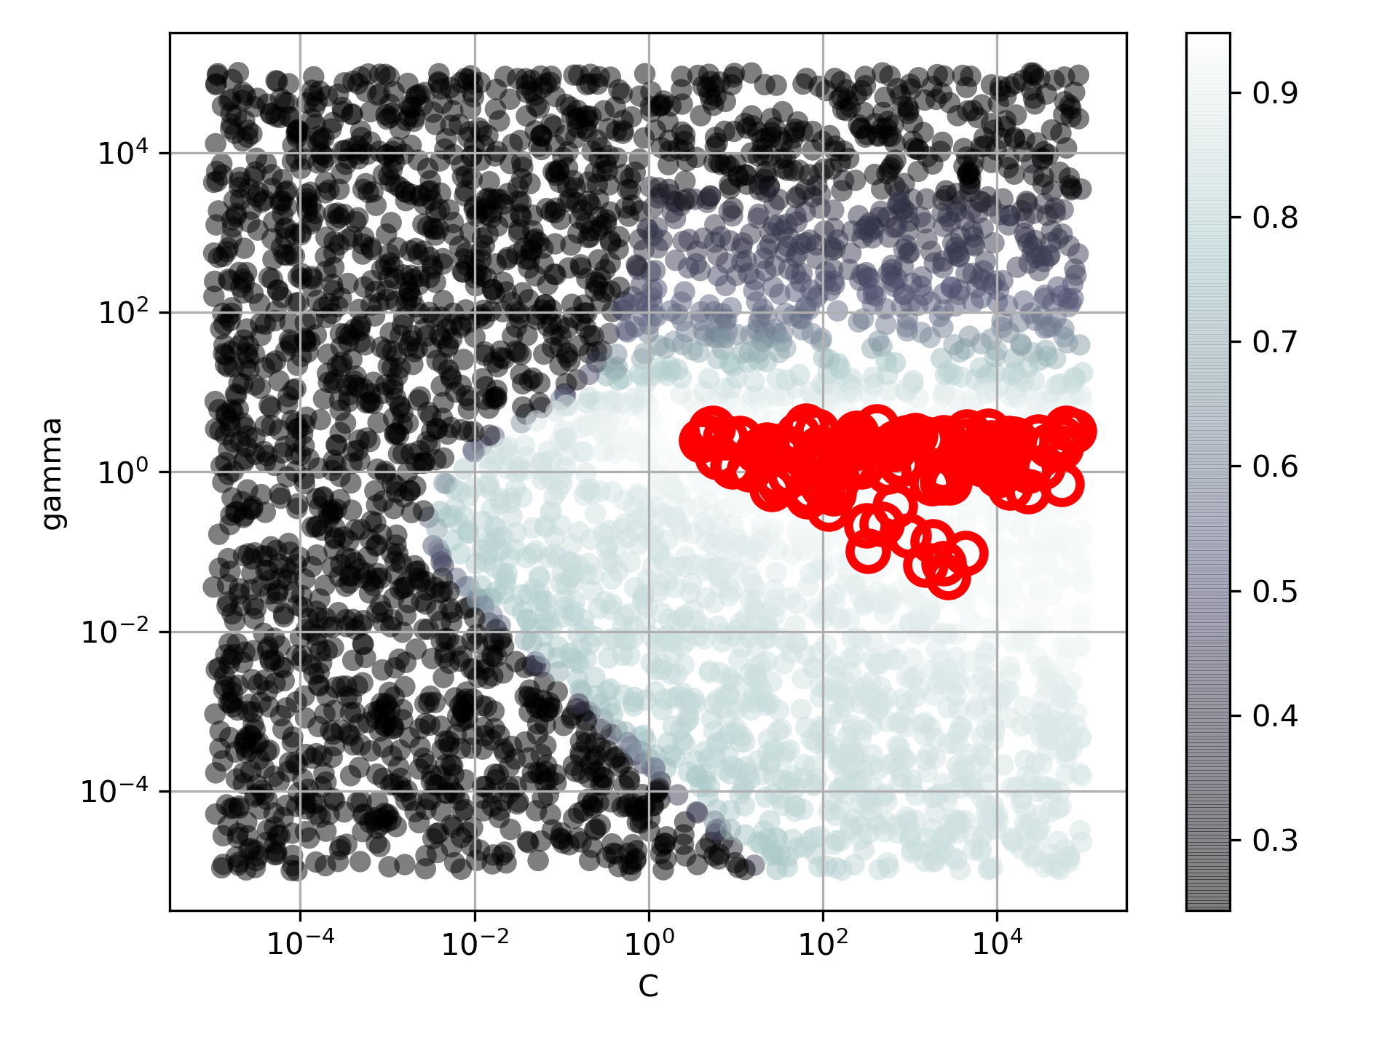
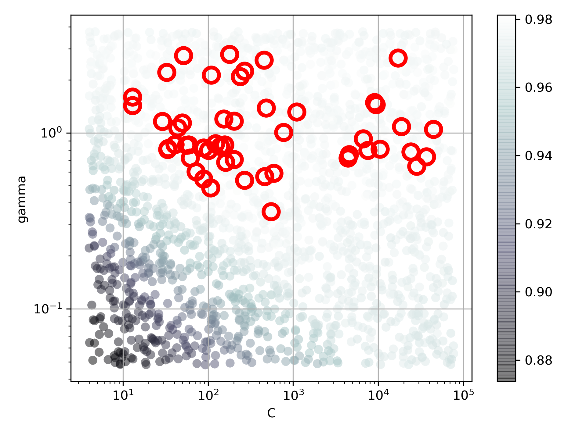
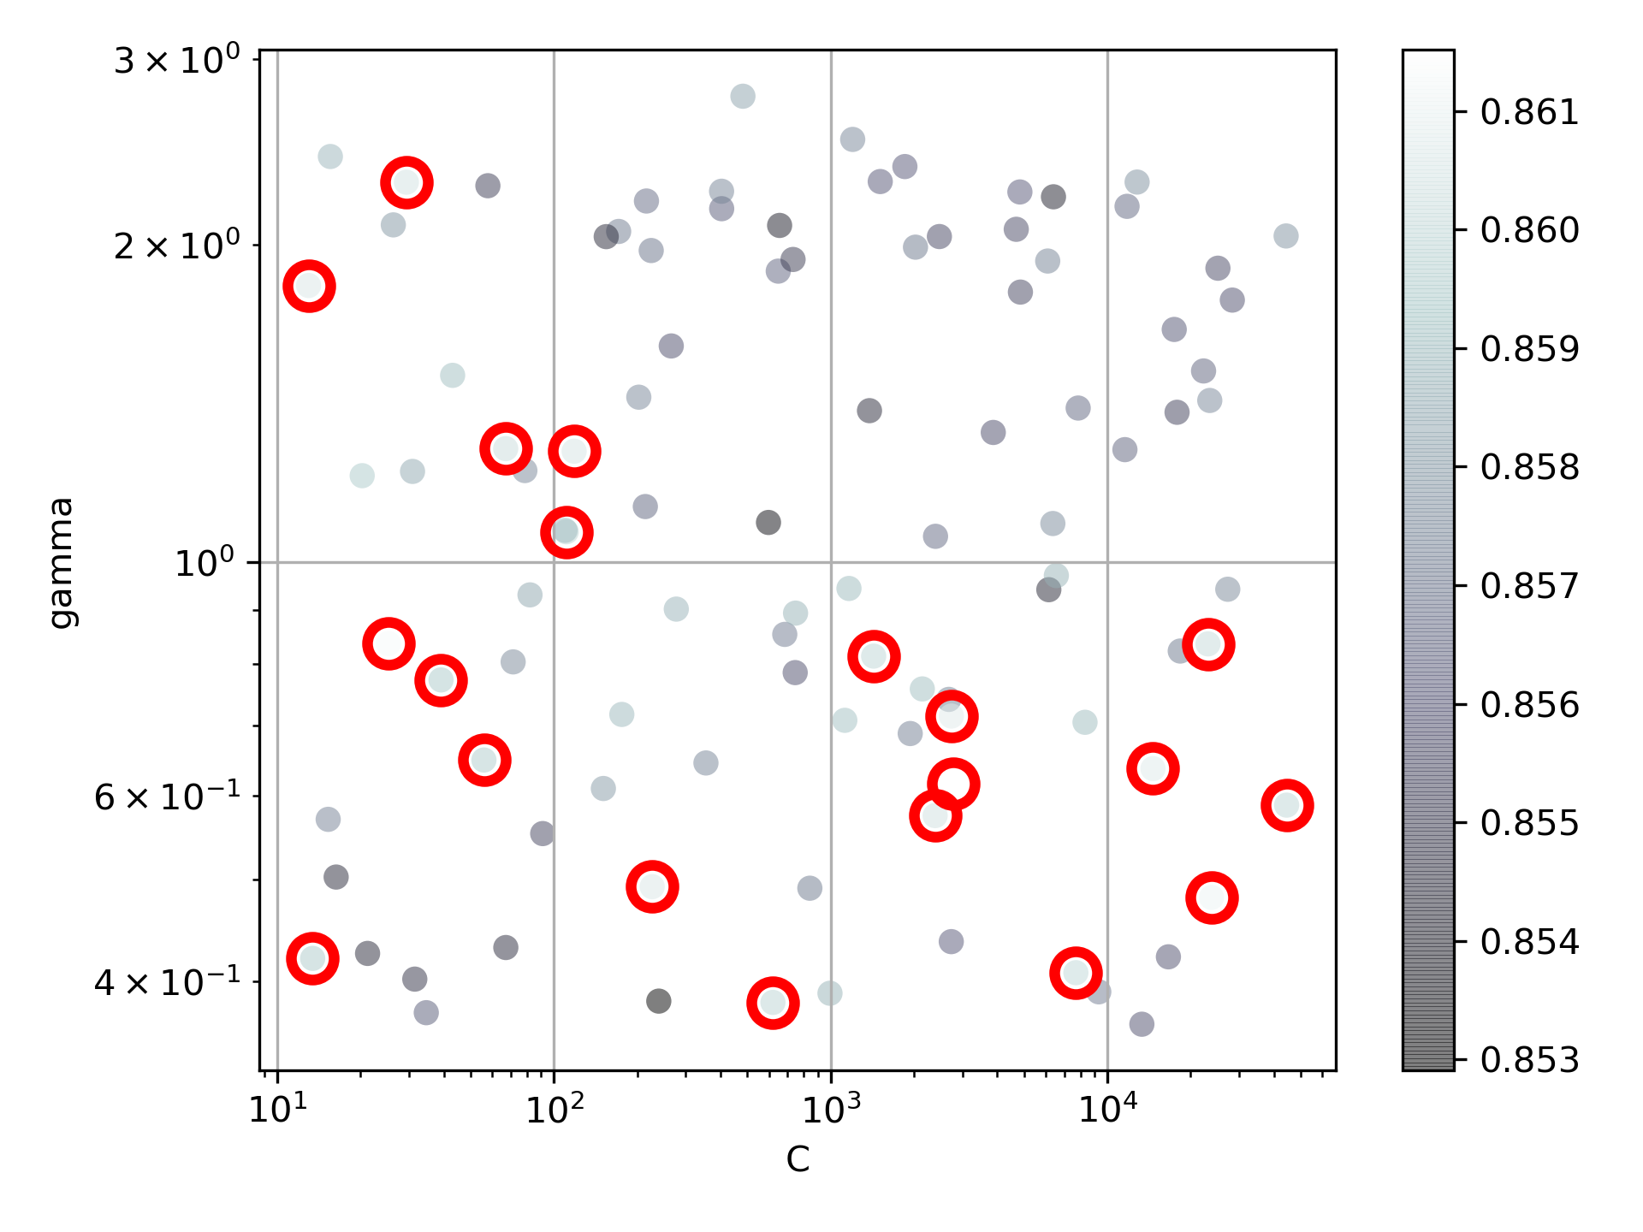
Step 4.4 – Find Best Hyperparameters Narrow Search
More data, narrow range
SVM: C and gamma
Samples: 20%
Iterations: 4000
Top Selection: 100
Samples: 40%
Iterations: 2000
Top Selection: 50
Samples: 100%
Iterations: 100
Top Selection: 20

Slide 18
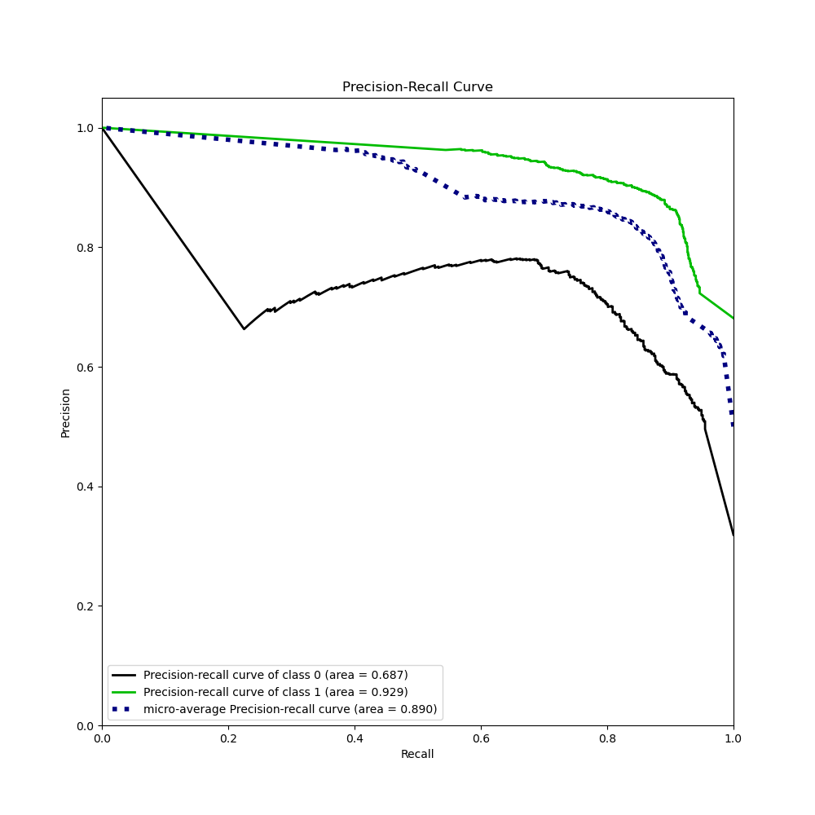
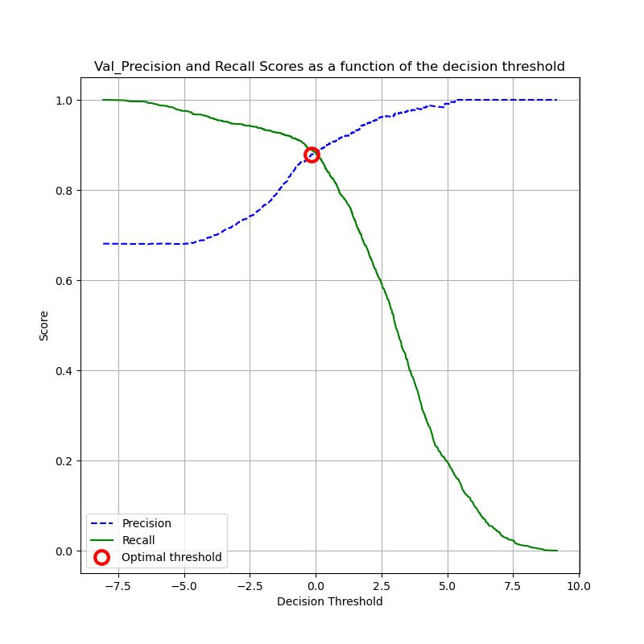
Step 4.5 – Find Precision Recall Threshold

Slide 19
Step 5.0 – Train Model
Best pipe for support vector machine:
Pipeline(steps=[
('scaler', QuantileTransformer()),
('sampling', ADASYN()),
('feat‘, ColumnExtractor(cols=[1, 2, 3, 4, 5, 6, 7, 8, 9, 10, 11, 12,
14, 15, 16, 23, 24, 25, 26, 28, 29, 30,
31, 32, 34])),
('svm', SVC(C=2786.3123139377217,gamma=0.6169115526350926))
])

Slide 20
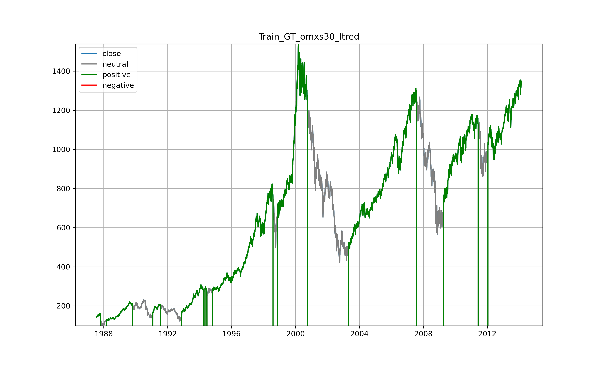

Step 6.1 – Evaluate on Training Data SVM
Almost perfect fit -> Overfitting?

Slide 21
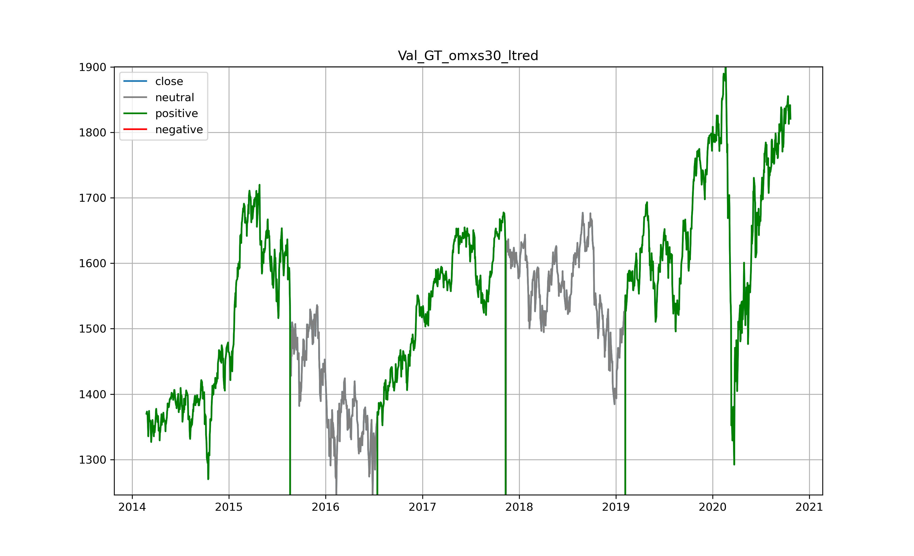
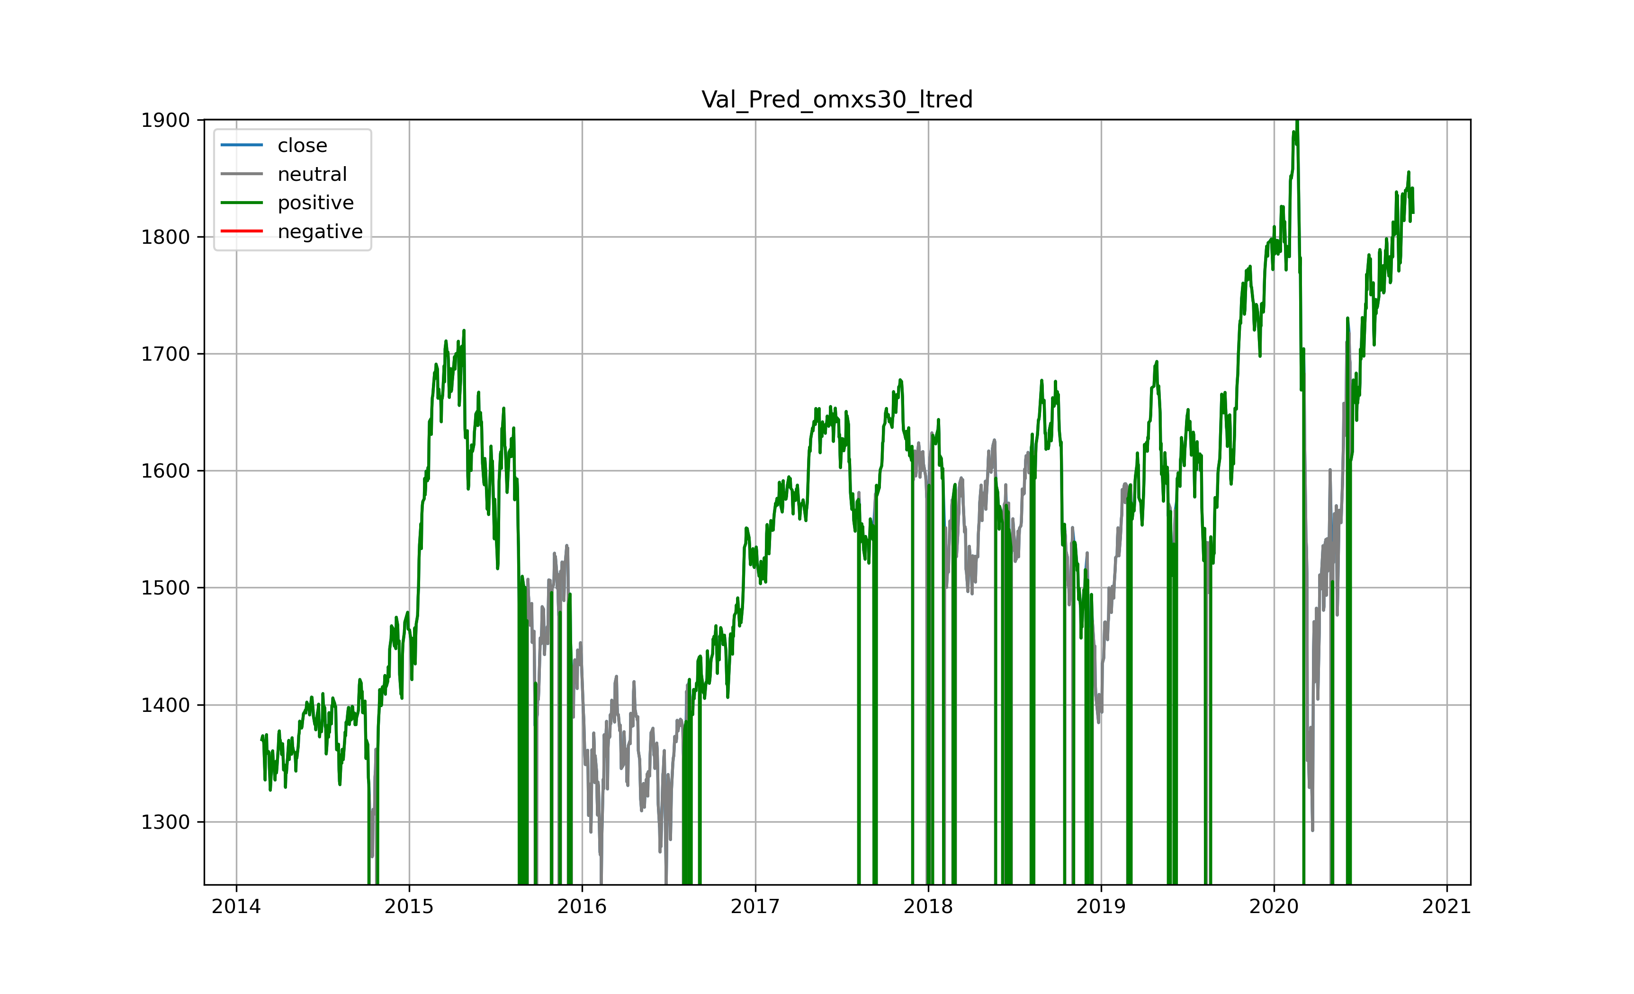
Step 6.1 – Evaluate on Validation Data SVM
Can you make money with this information?
Need additional filter
Corona

Slide 22
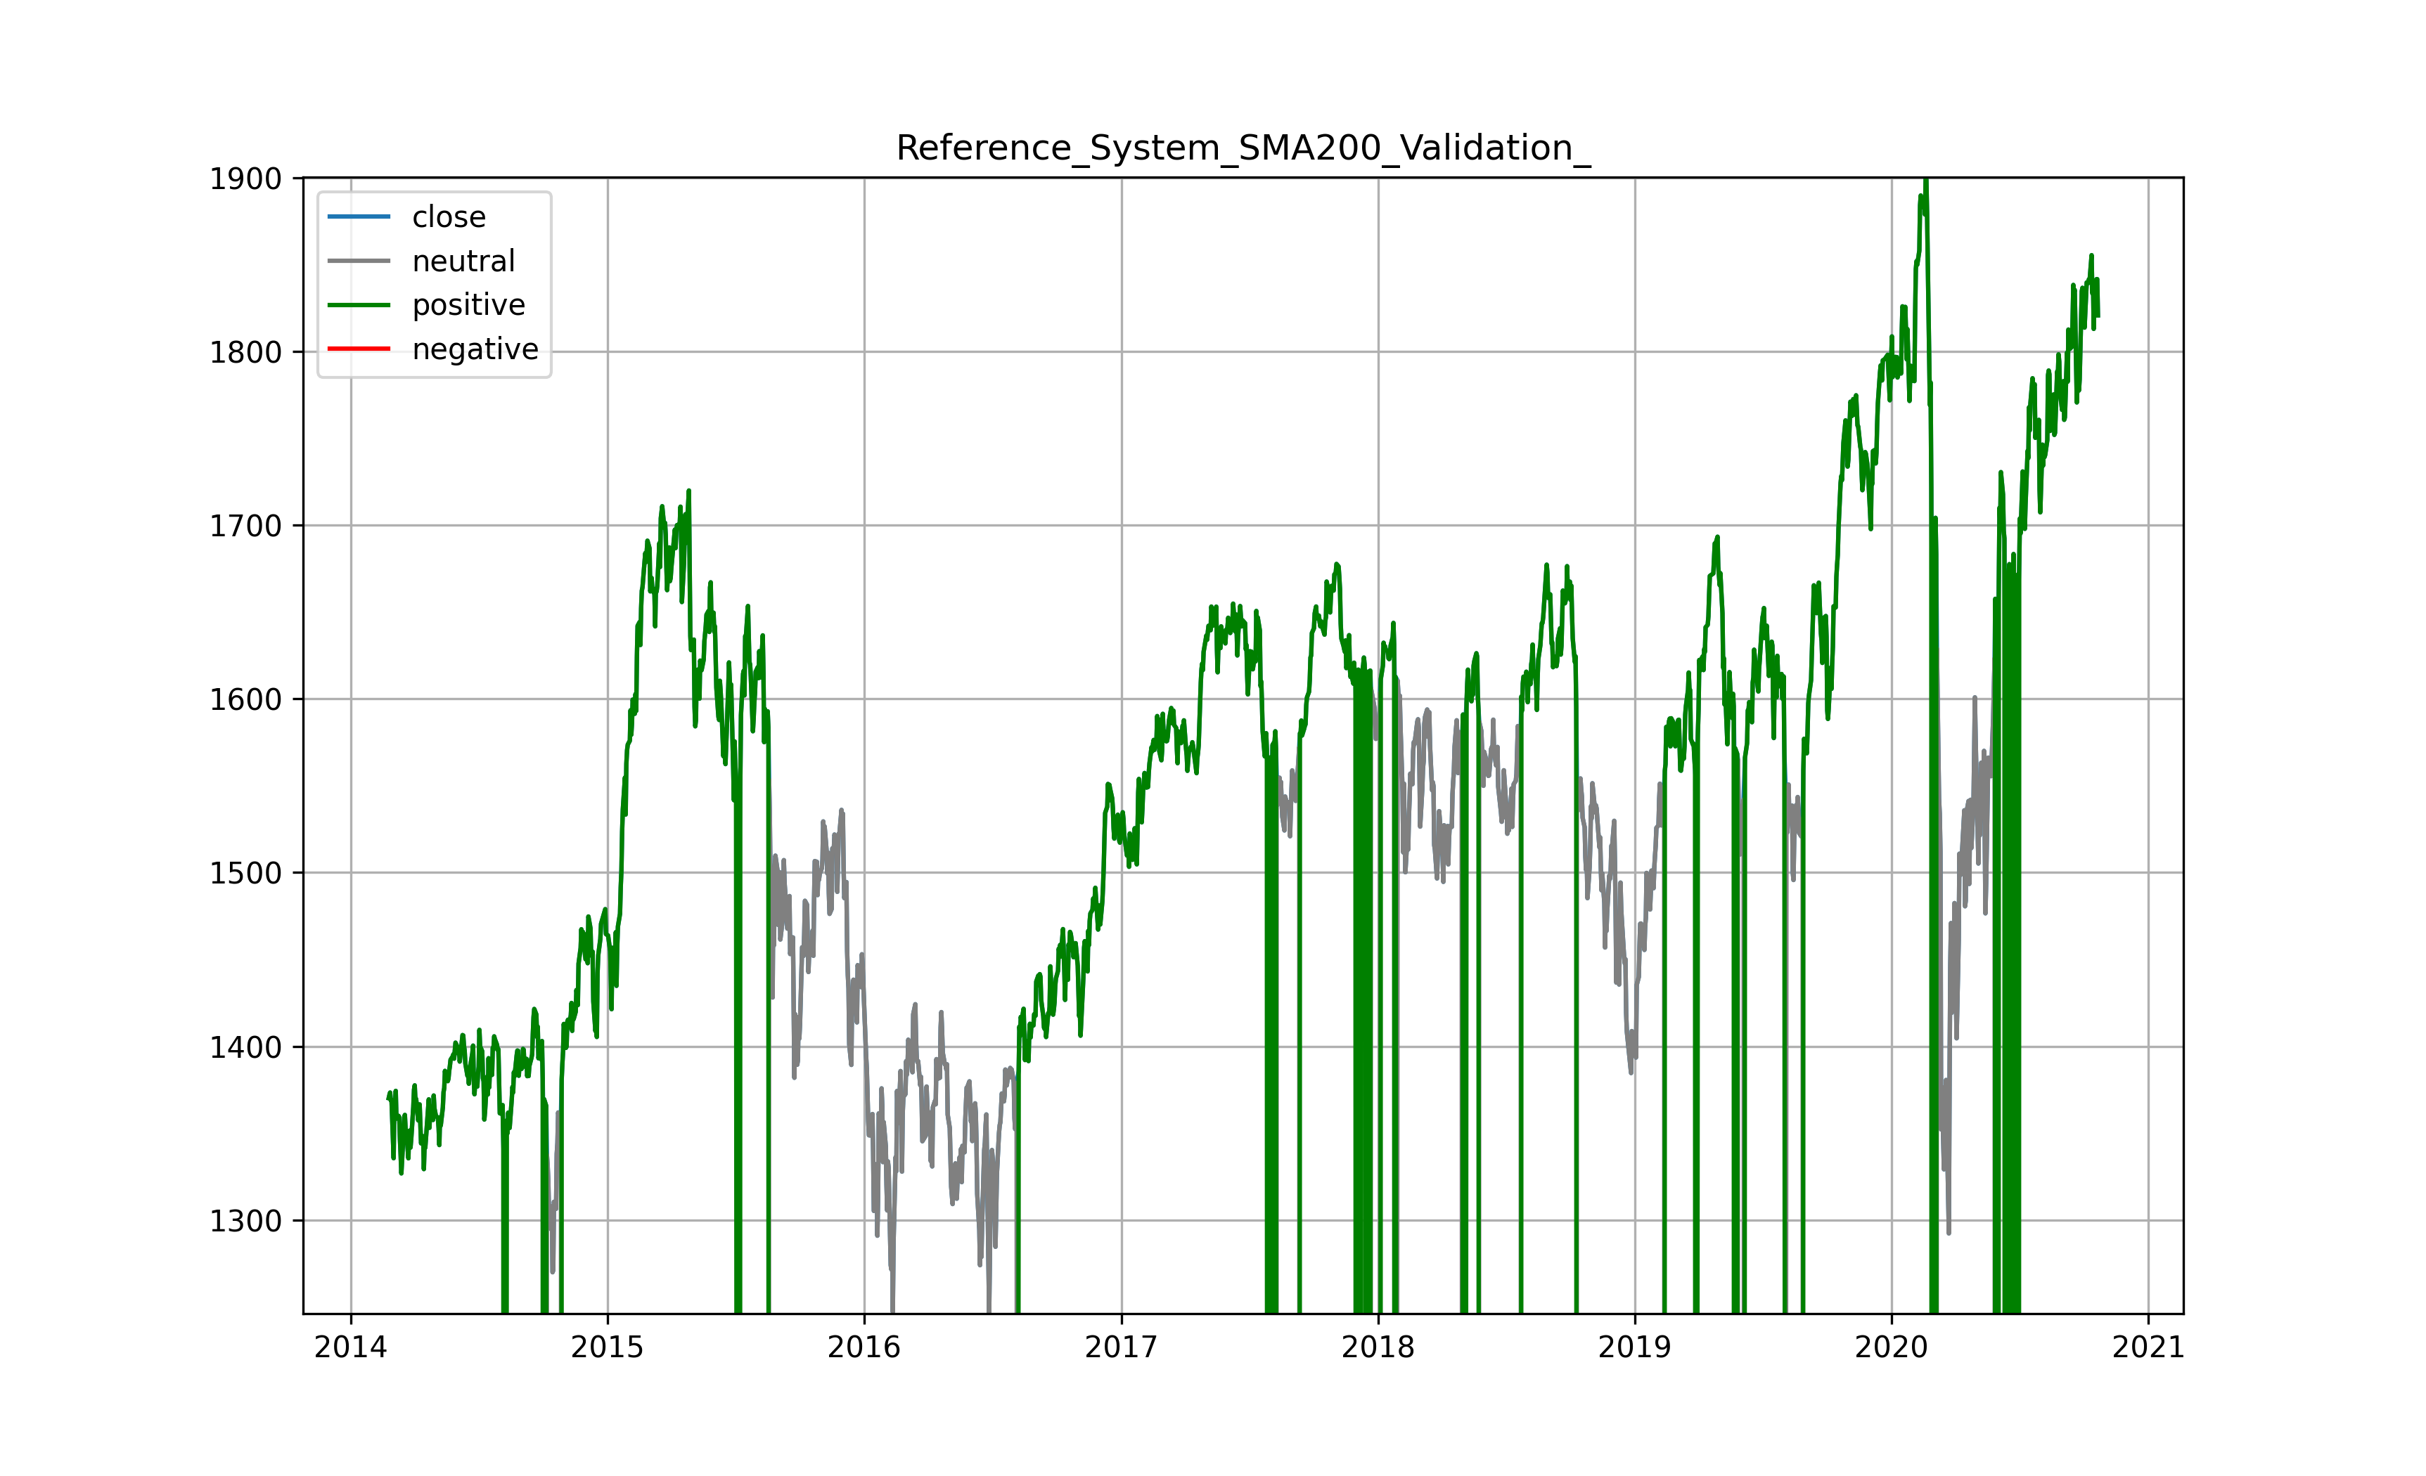
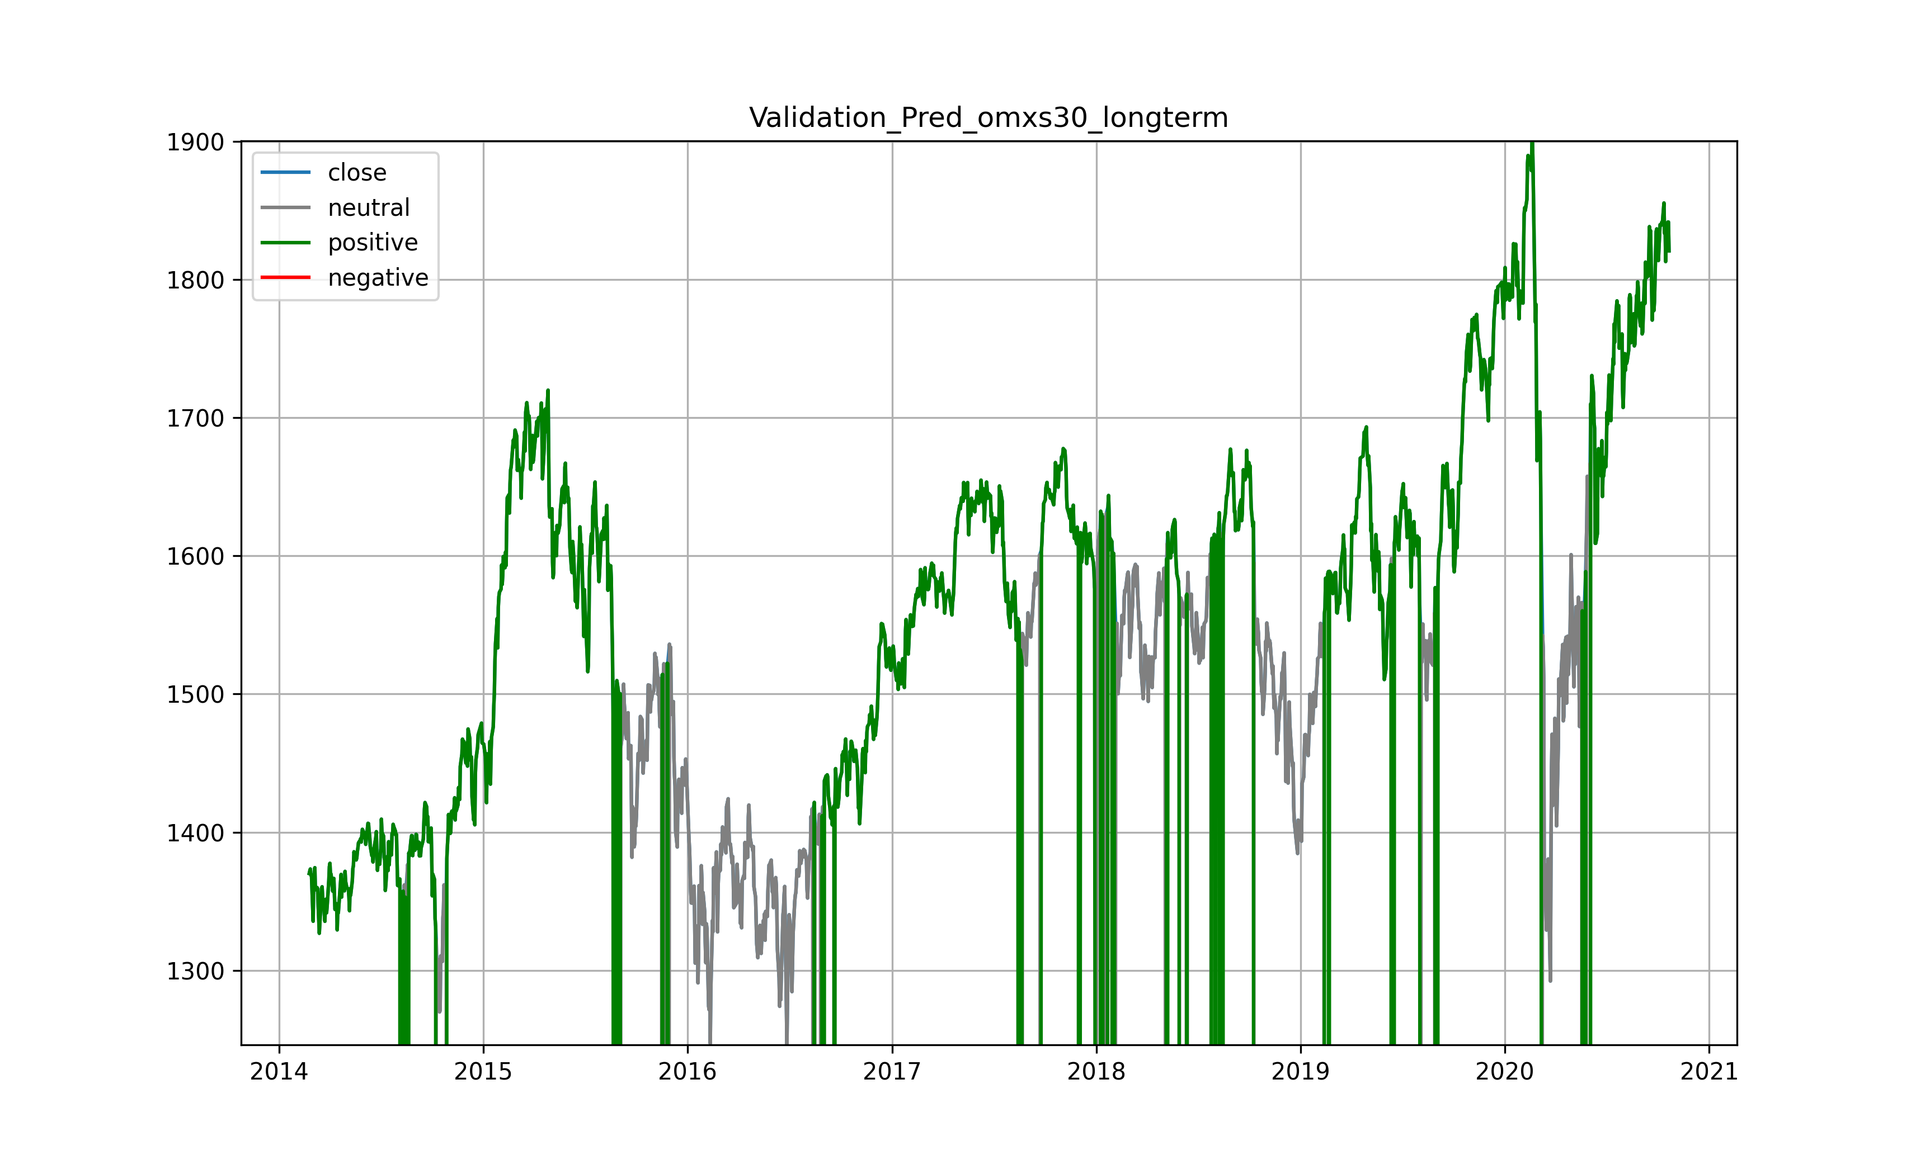
Step 6.1 – Evaluate Other Models
Simple moving average 200 days (SMA200)
XG Boost
Similar looking: Knn, linear SVM, Gaussian Naive Bayes

Slide 23
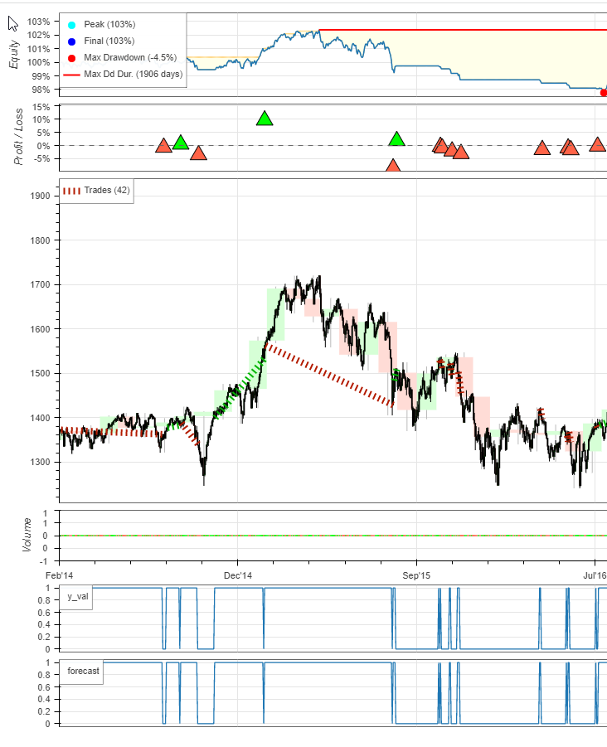
7.2- Simple Trading System
Positive trend prediction -> Buy
Negative trend prediction -> Sell
Result
Buy and hold: +28%
Any model strategy: +1% to +4%
Validation market too choppy

Slide 24
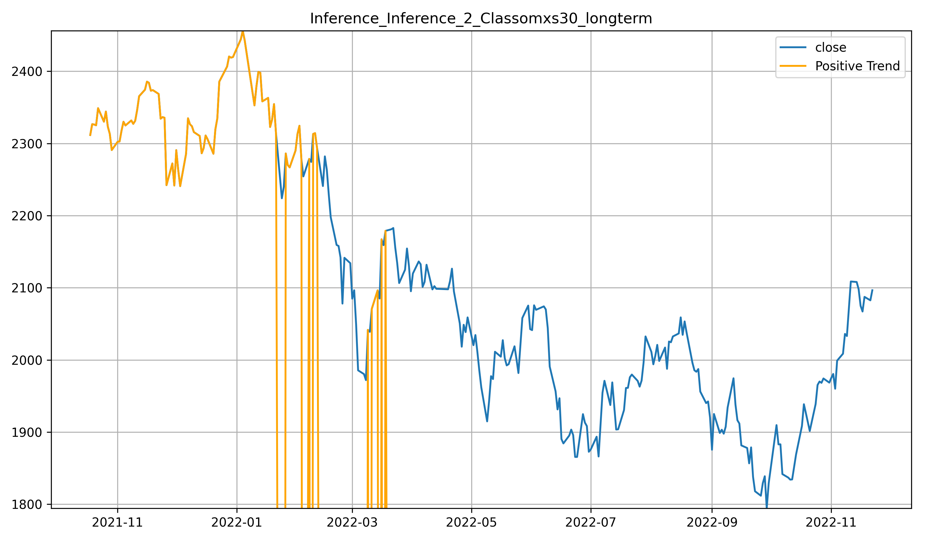
Step 7.0 – Prediction 2021-2022 with SVM
Still negative trend!
Filter weak signals
Model lags
Professionals say: „5 months after a major bull top, you can recognize it“
Consider other indicators:

Slide 25
Conclusion
Huge effort reduction for similar datasets and reproducibility
…but each dataset is unique
Know your code
Know your data
Script templates available in github https://github.com/alexanderwendt/sklearn_ml_toolbox
https://github.com/alexanderwendt/sklearn_ml_toolbox_samples
Stock market: Hard to make money with machine learning

Slide 26
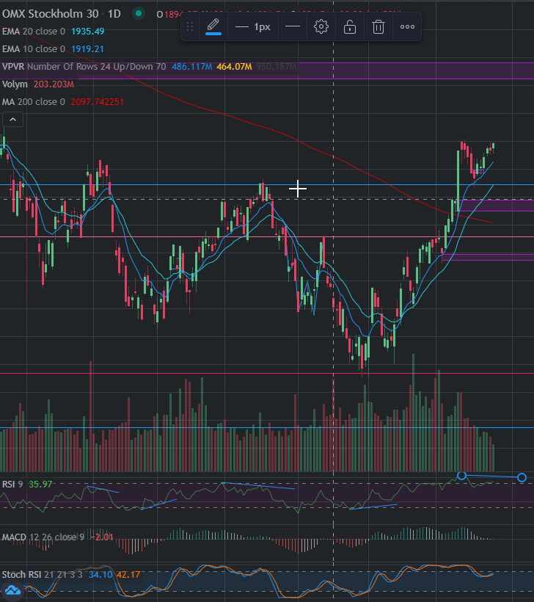
Future Work
No LSTM to predict price
Like a moving average
„Market Structure“ model
Locate big players‘ trading zones
Capture divergences in indicators
RSI, MACD
Image recognition to find structures
Cup with handle

Slide 27
Thank you for your attention!

Slide 28
Extra Slides

